Slide 1
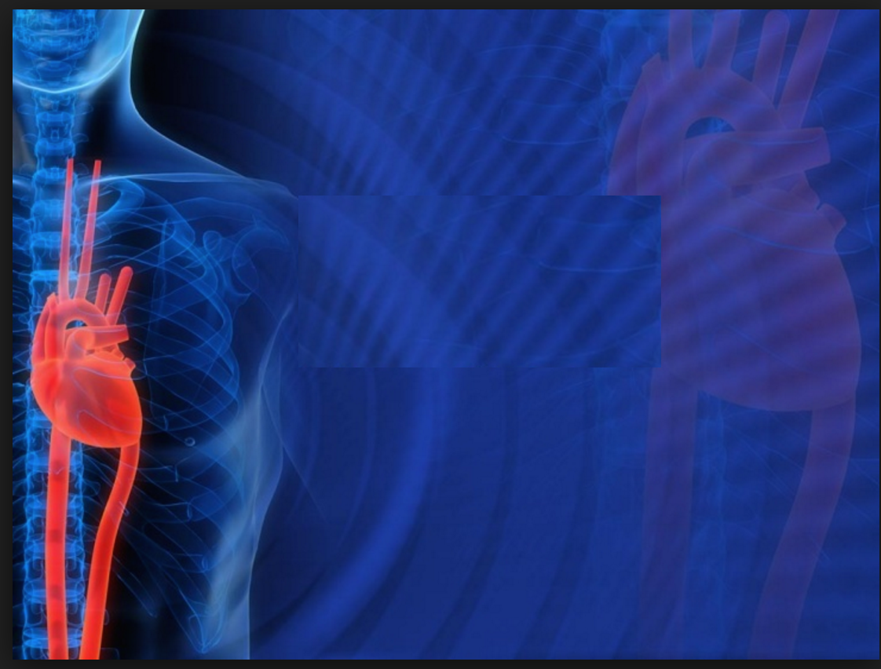
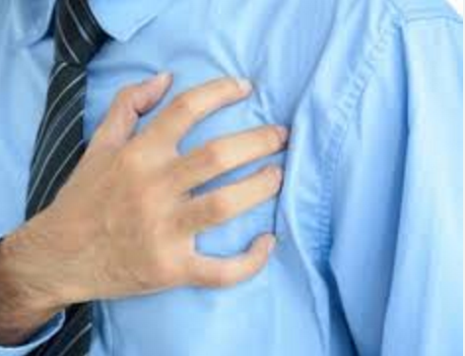
LIVE LONGER WITH
HEART DISEASE
Erik N Tulasi R Youqing
Notes:
Presenter: Tulasi (~ 5 seconds)
Live longer with heart disease - That’s our topic.
Erik?

Slide 2
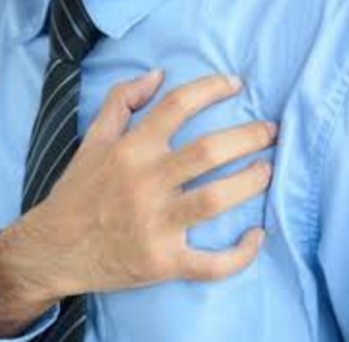
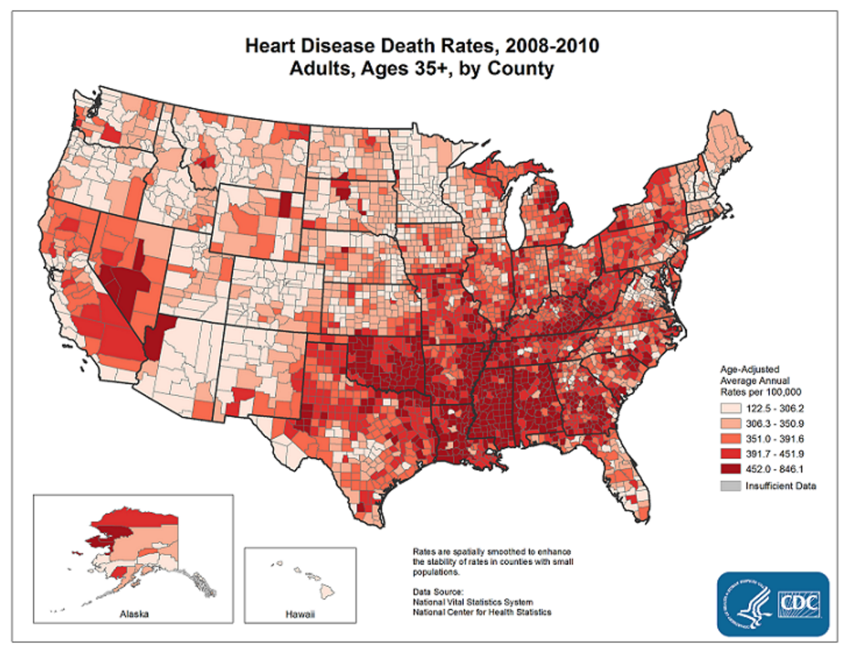

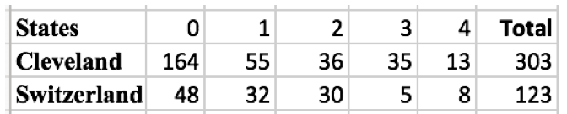
Notes:
Presenter: Tulasi (~ 25 seconds)
Close to 600 million people die of heart disease every year in the U.S and that is 1 in 4.
As you can see, The lowest death rates are in the west and the highest in the south. We used a dataset from Cleveland, OH.
Once a person starts showing risk factors like high blood pressure, high cholesterol….then they enter a cycle like we will show you. Erik?

Slide 3
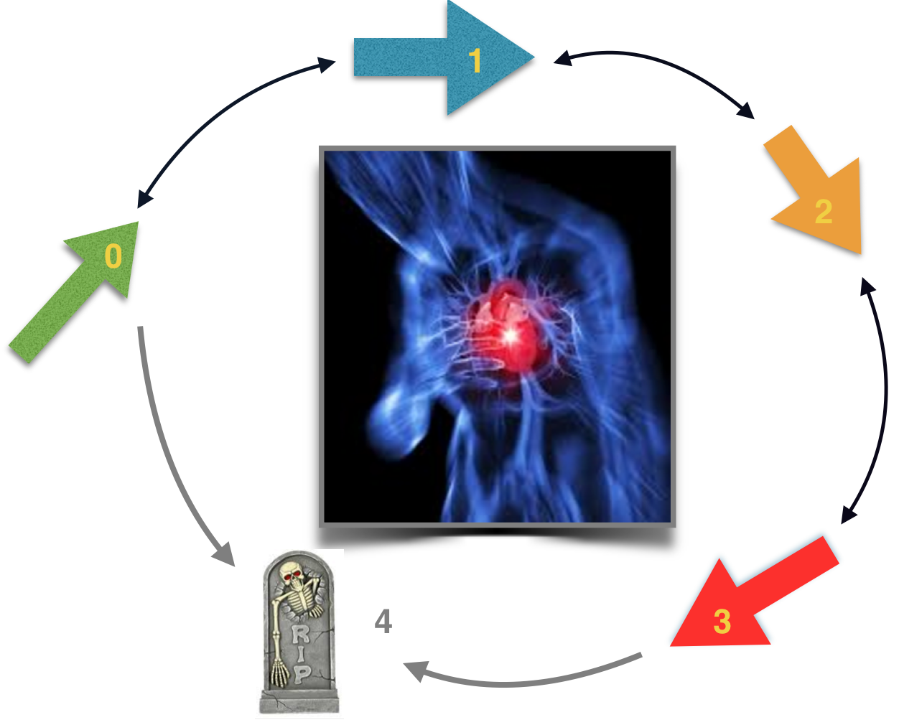
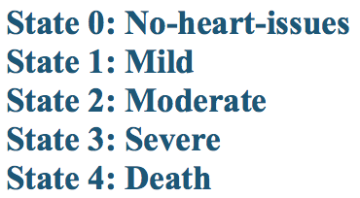
Progression of heart disease in different Stages
Notes:
Presenter: Tulasi ( ~ 35 secs)
The person enters this cycle at State 0( the green arrow) ( no heart issues - but has certain risk factors). Then goes to State 1 with mild issues
and so on until State 4(which is death). So you can see that once a person has one of the risk factors like high blood pressure,
that person is already in this loop and it’s a matter of time before the progression happens towards Stage 4.
So, it really critical to think about slowing down this disease in these states. If the disease is caught in the earlier stages,
medical expenses are lower.
Our team wanted to simulate the possible scenarios to slow down this disease.
For that, we reduced the description of the disease into five states called Markov states – State 0 – no-heart issues, State 1 – mild, etc. Erik?

Slide 4
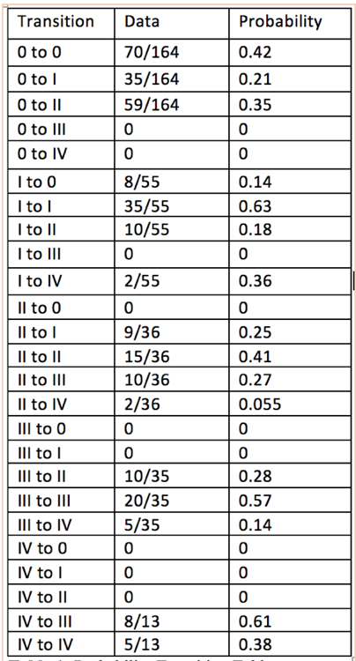
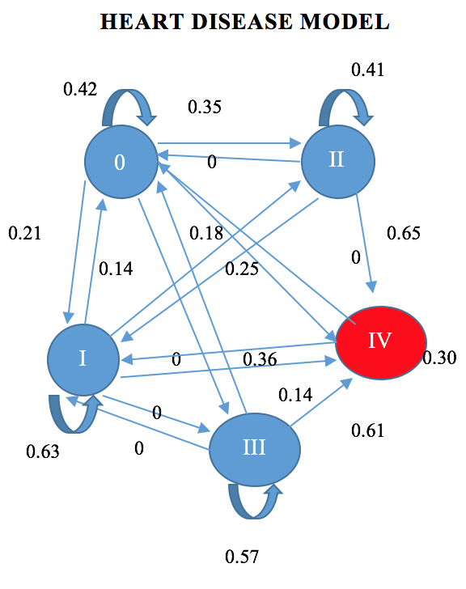
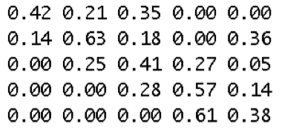
Methodology
Probability Transition Table
Markov Model
Matrix form
Notes:
Presenter: Tulasi ( ~ 25 secs)
We first created a probability transition table and assigned values to each of these states.
Then represented it as a Markov Model and converted into a matrix as shown to the right end.
What happens if you get intervention/ that is help in Stage 2 ? How will that effect the prognosis of a patient?
Can that be quantified? These kind of questions are answered for you in this research project.
Erik?

Slide 5
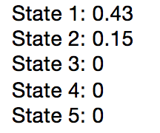
ASSUMPTIONS
Markov states.
An initial distribution →
Can die in any state.
Transitions - from low to a way higher state and vice versa
Notes:
Presenter: Tulasi ( ~ 35 secs)
We made certain assumptions – like
A patient is always in one of a finite number of states (the Markov states. )
We used arbitrary initial distribution as a starting point for the simulation
A patient can die in any state.
Transitions can occur from a lower to a higher state, example from state 1 to state 3.
Erik?

Slide 6
Simio Model
Model Components
Source: General population
Servers: Different States of the Disease
Infinite capacity
Paths: Weighted to Represent Probabilities in the Transition Matrix
Sink: State 4 (Death)
Notes:
Presenter: Erik
Go over highlights of the Model
The Objectives of the model
Get a sense of how patients move through the model
Create a model that allows us to make interventions easily
Create a model that allows us to create different types of patients
Create a model that can be adapted to include cost and other options
Display a short run of the Simio Model
Erik, can you state the “objectives” of the project
To develop a create an MCMC that allows us to describe a patients progression through the different states of heart disease.
Allow for experimentation of interventions.

Slide 7
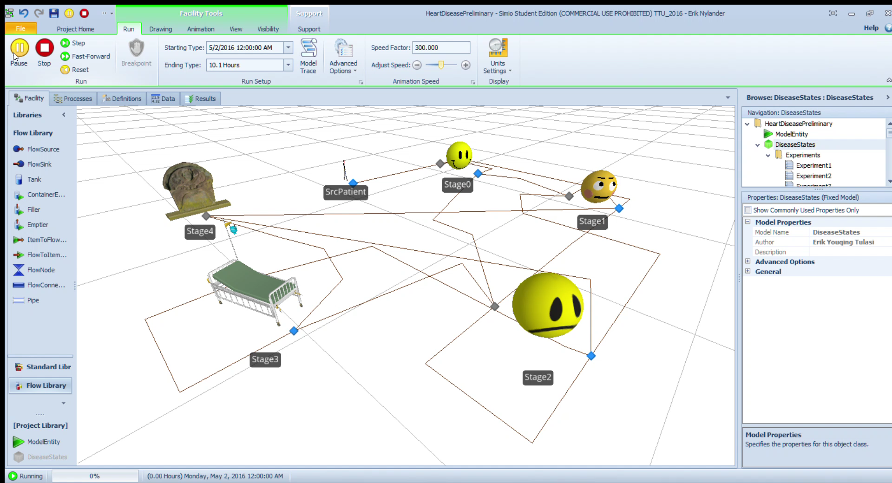

Slide 8
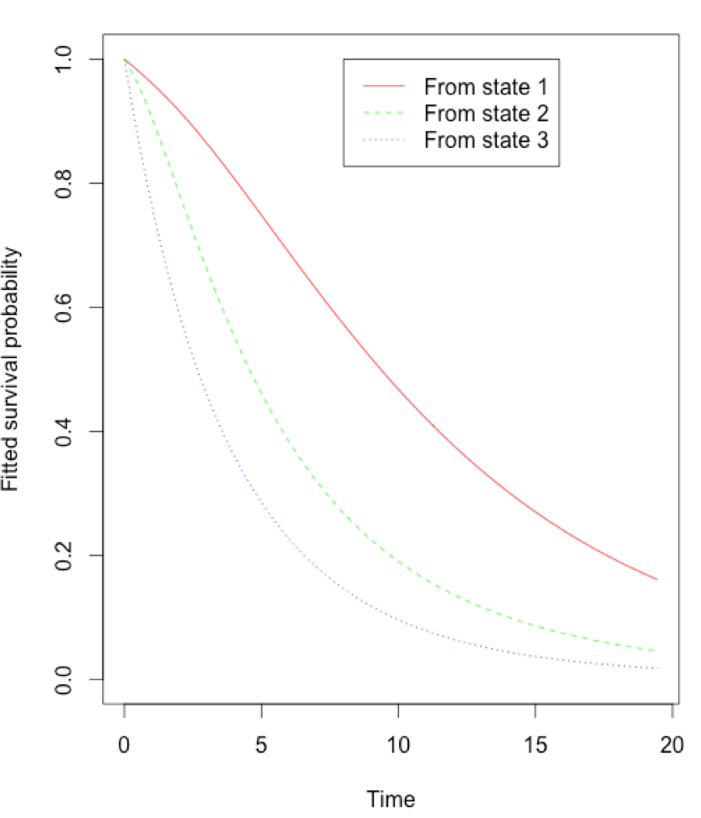
R and Simio
10 Year Simulation
Survival Rate: 67.8%
Average Time with Disease: ~6 years
Minimum Survival Time: ~2 Years
Notes:
Presenter: Erik
Compare R with Simio

Slide 9
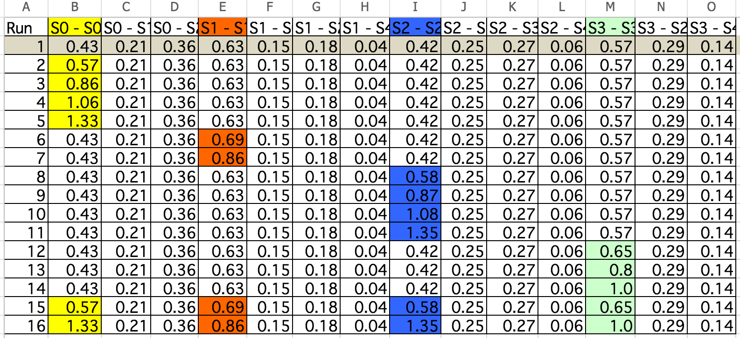
Overview of Interventions In Model
Notes:
Presenter: Youqing(Discussion of how we changed the model to show interventions)
Explain: how to set up the whole simulation. (around 2mins)

Slide 10
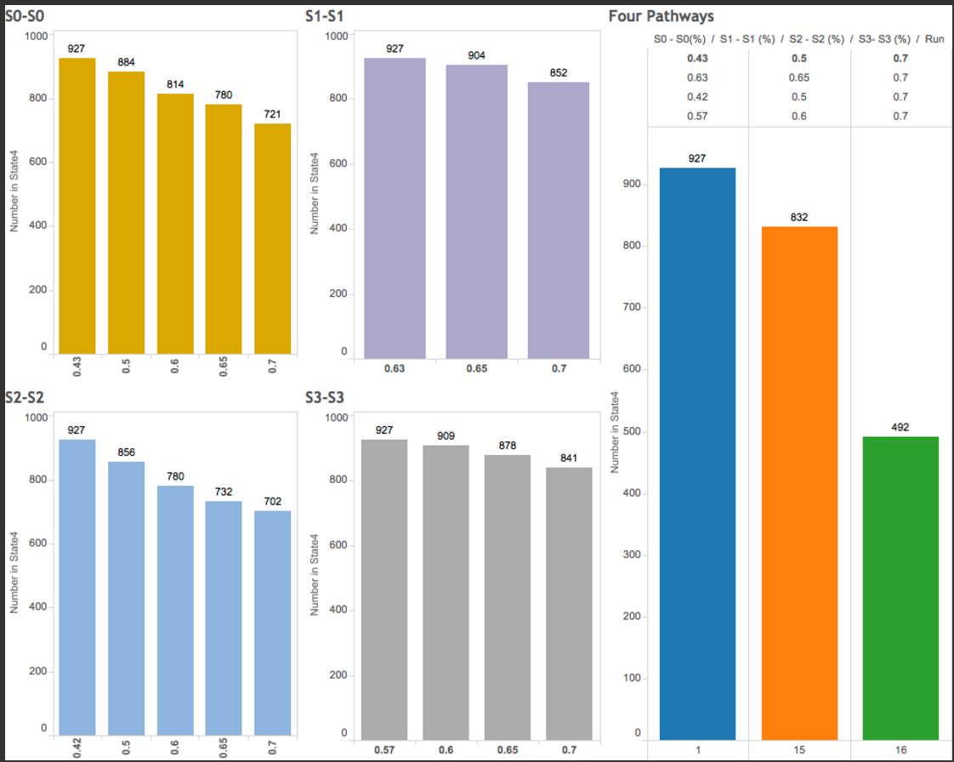
Results - Single & Multiple Interventions
Notes:
Presenter: Youqing
Explain the result and what our model suggested. (around 2mins)

Slide 11
CHALLENGES
Dataset with time-series was hard to find.
We had somewhat limited data sets in time and location
Given the Monte Carlo Nature this was easier to implement in R than Simio
Simio did give us a nice way to look how individuals progressed through the transitions.
Notes:
Presenter: Erik
(Time: adjust to the remaining time)

Slide 12
Future work
Consistency, Efficiency
Having patients that progress more or less quickly through the disease.
Calculating transition probabilities based on characteristics of each patient.
Including cost involved in patient care at each state of the disease.
Notes:
Presenter: Erik
(Time: adjust to the remaining time)

